Slide 1



IoT & The Cloud
Free Friday Workshop
February 9, 2024

Slide 2

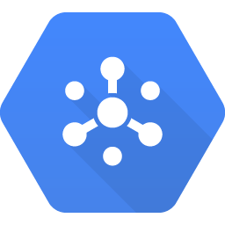

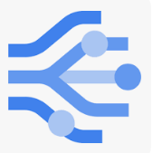


IoT & The Cloud
AGENDA
Welcome & Intros
Goals for the Day
IoT Overview
Raspberry Pi Hardware Setup
Google Cloud Platform (GCP) Environment
Ingesting Telemetry Data
Storing the Data
Alerting & Reporting on the Data
Futures
IoT Topic Cloud Pub/Sub
Storage BigQuery
Alert App Integration
Analysis Looker Studio

Slide 3
LEARN A LOT!
HELP EACH OTHER OUT
HAVE FUN
GOALS FOR THE DAY

Slide 4
IoT
RPI
GCP
Math’s
Page 2
Science
Page 4
Social
Page 6

Slide 5
IoT
RPI
GCP
Internet of Things Overview
What is IoT?
Telemetry explained
Updating & Managing Devices
Big 3 cloud providers
Use Case examples

Slide 6
IoT
RPI
GCP
Internet of Things Overview
Page 2

Slide 7
Everyone on same page?
Image here
Help each other out
CHECKPOINT

Slide 8

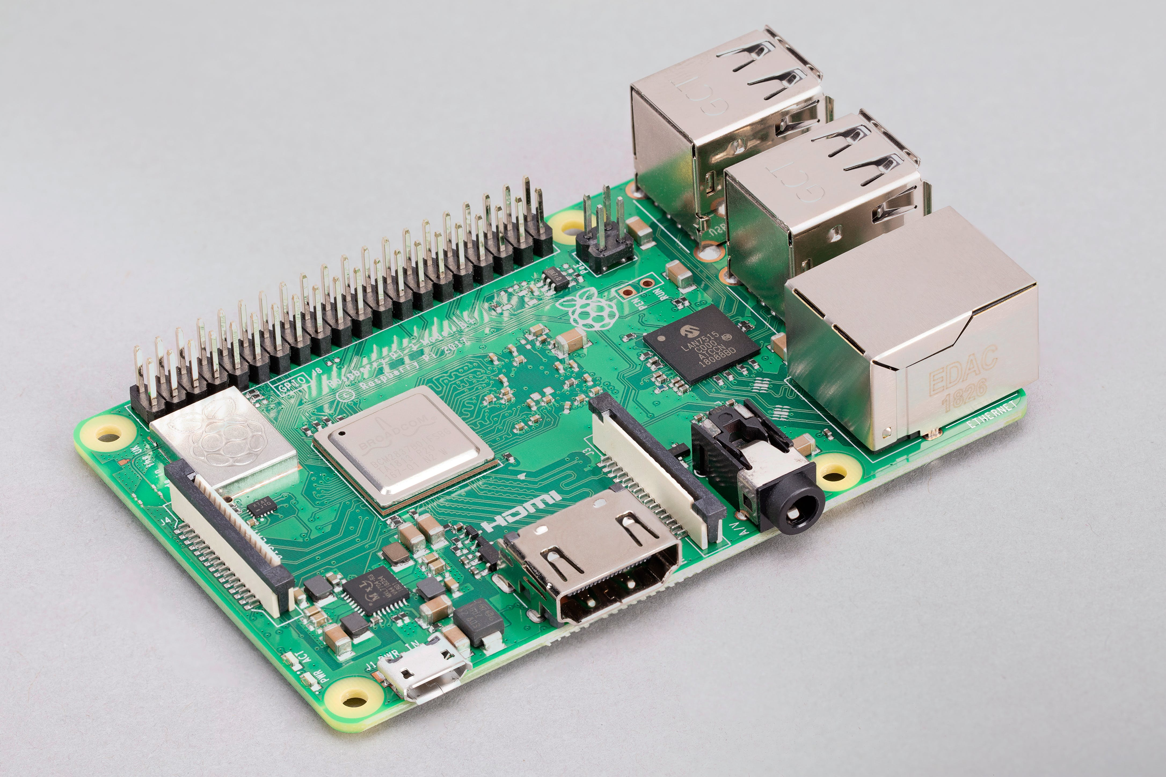

IoT
RPI
GCP
Raspberry Pi Overview
What is it? (bring the W and zero)
Short History - https://www.deviceplus.com/raspberry-pi/the-history-of-raspberry-pi/
GPIO

Slide 9
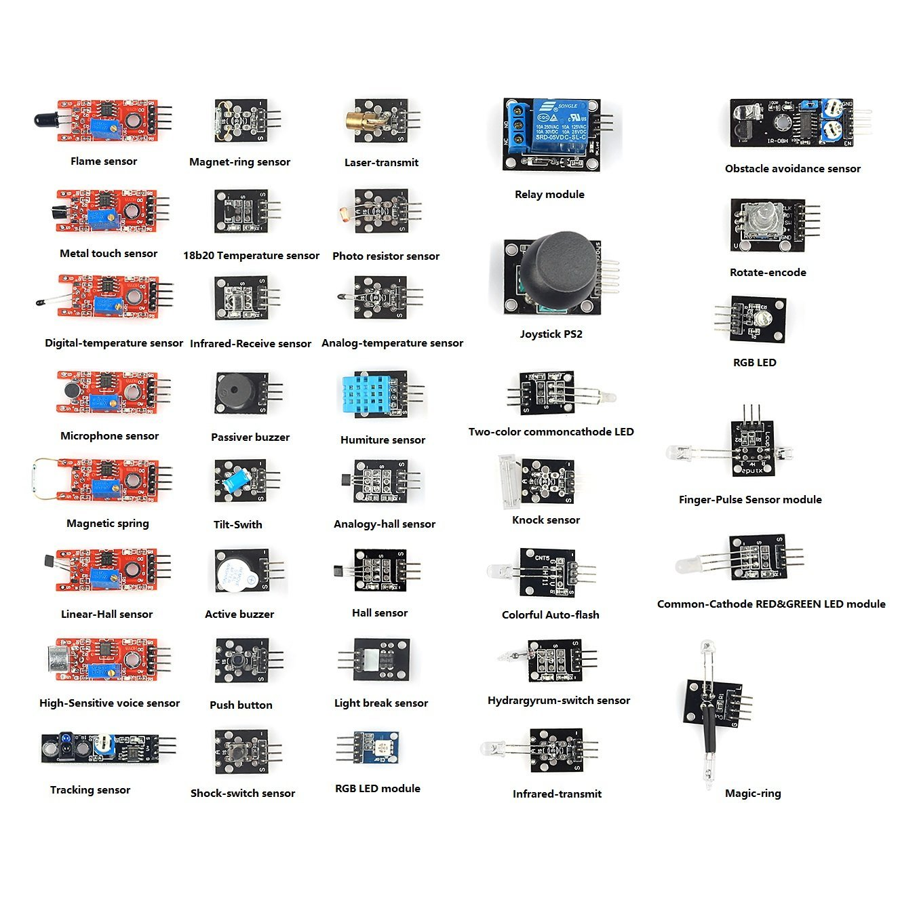
IoT
RPI
GCP
Raspberry Pi Overview
Sensors: temp, humidity, light, fire, sound, motion, IR, joystick, etc.

Slide 10
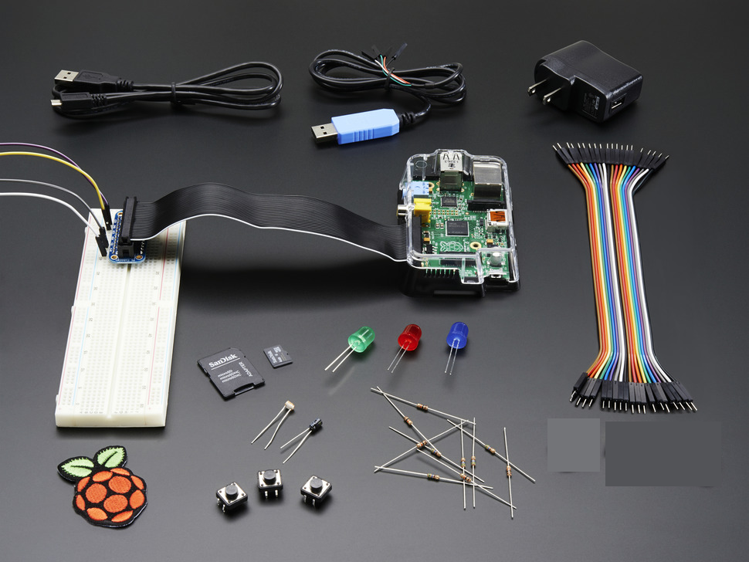
IoT
RPI
GCP
Raspberry Pi Overview
Initial setup
Unbox
Initial startup and O/S install (pics)
What’s in the box??

Slide 11
IoT
RPI
GCP
Raspberry Pi Overview
Raspberry Pi 3 Model B
SD Card with Raspbian OS
Pi Case
5v Power Supply
Breadboard and Jumper wires
Leds & Resistors
GPIO breakout ribbon cable
USB jumper (not used)
Raspberry patch
DS18B20 Temp Sensor
What’s in the box??

Slide 12
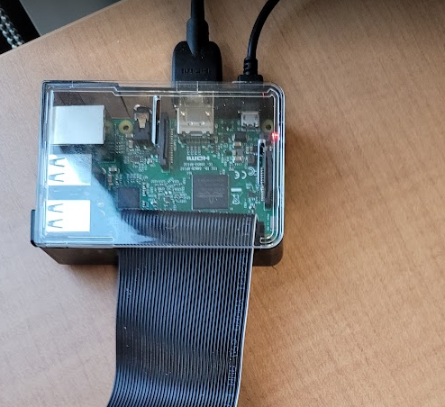
IoT
RPI
GCP
Raspberry Pi Overview
Cable it up:
Power supply
SD Card
HDMI monitor
Keyboard
Mouse
Update this pic

Slide 13
IoT
RPI
GCP
Raspberry Pi Overview
Initial Launch – 64-bit – Linux debian 12 - bookworm
Config wlan (join waketech)
Default user is pi / pswd is raspberry (reset the pswd?)
Test the logoff / back on process
Maybe run update and install Thonny here??
Screenshots from RPI

Slide 14
IoT
RPI
GCP
Raspberry Pi Overview
Hook up the GPIO here
Attach breadboard
Remember that ribbon faces in on the GPIO board inside of Pi (add a pic)
Close Case
Update this pic

Slide 15
IoT
RPI
GCP
Raspberry Pi Overview
Console in and launch a terminal
Check version of Python installed
Launch Thonny IDE
Install RPi.GPIO, W1thermsensor and GCP modules
Be sure to activate the venv
Screenshots from RPI

Slide 16
IoT
RPI
GCP
Raspberry Pi Overview
Page here with some basic info about circuits – resistors, LEDs, voltage, breadboard, etc
Also talk about safety / heat

Slide 17
IoT
RPI
GCP
Raspberry Pi Overview
Cable up the breadboard and LED stuff
Start with LED code – good site is: https://thepihut.com/blogs/raspberry-pi-tutorials/27968772-turning-on-an-led-with-your-raspberry-pis-gpio-pins
Need to note this step (run sudi nano – think you have to reboot for this to take effect?? - yes): add this code to the /boot/config.txt file: dtoverlay=w1-gpio,gpiopin=4
Also remember this: to check if sensor is recognized: cd /sys/bus/w1/devices then do an ls – should see a sensor id starting with a "28"
DS18B20 will get hot if polarity is wrong

Slide 18
IoT
RPI
GCP
Raspberry Pi Overview
LED Code stuff
import os import time import datetime import RPi.GPIO as GPIO # Import Raspberry Pi GPIO library from w1thermsensor import W1ThermSensor, Unit # Import temp sensor library from google.cloud import pubsub_v1 import json # Set GCP variables for connection #os.environ["GOOGLE_APPLICATION_CREDENTIALS"]="/home/pi/PycharmProjects/SensorTest/jkb-iot-project-5575900f169f.json" #project_id= "jkb-iot-project" #topic_name = 'iot-sensor' os.environ["GOOGLE_APPLICATION_CREDENTIALS"]="/home/pi/PycharmProjects/SensorTest/iot-class-410121-29be3e3bc63c.json" project_id= "iot-class-410121" topic_name = 'iot-sensor' publisher = pubsub_v1.PublisherClient() topic_path = publisher.topic_path(project_id, topic_name) os.environ['TZ'] = 'EST+05EDT,M3.1.0,M11.1.0' time.tzset() # Setup the GPIO board on the Raspberry Pi... GPIO.setwarnings(False) # Ignore warning for now GPIO.setmode(GPIO.BOARD) # Use physical pin numbering

Slide 19
LUNCH BREAK

Slide 20
IoT
RPI
GCP
Google Cloud Platform (GCP)
STEP 1: Create GCP Account
This should be done as prework – so maybe just confirm that everyone can successfully log in to their account

Slide 21
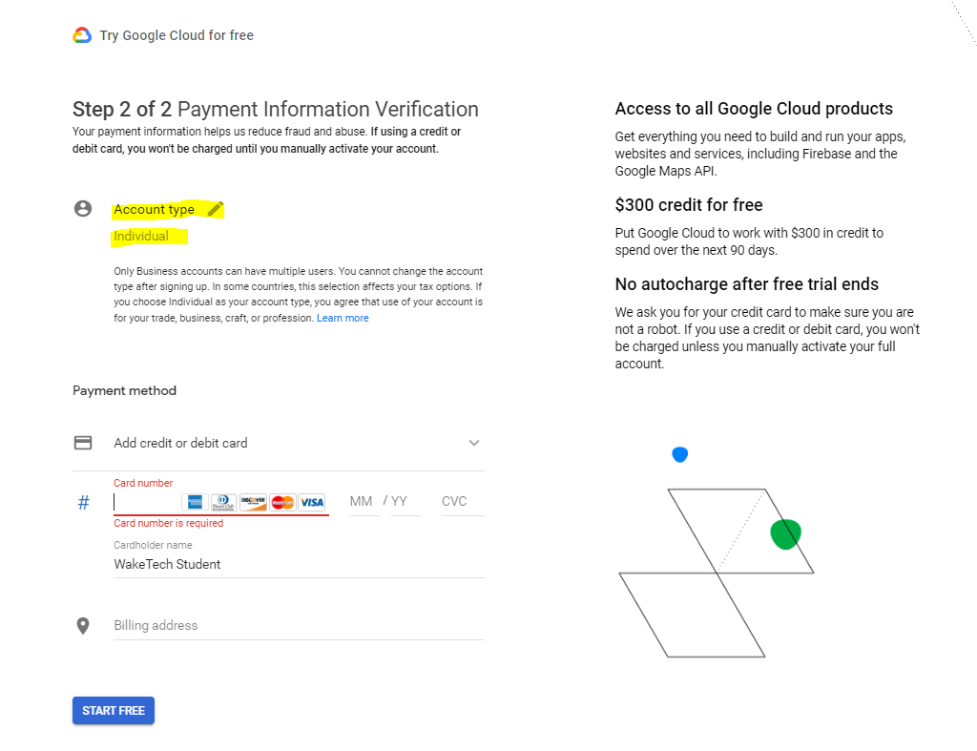
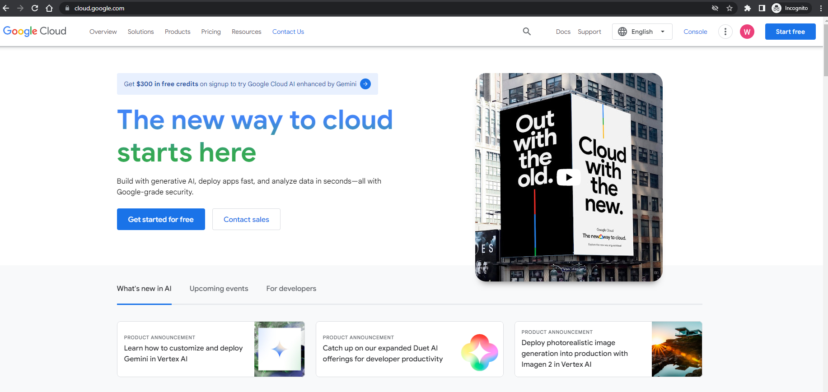
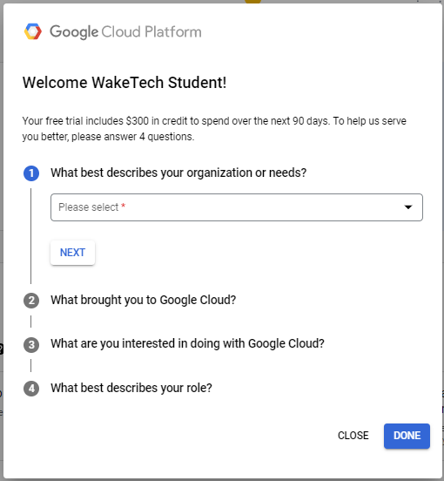
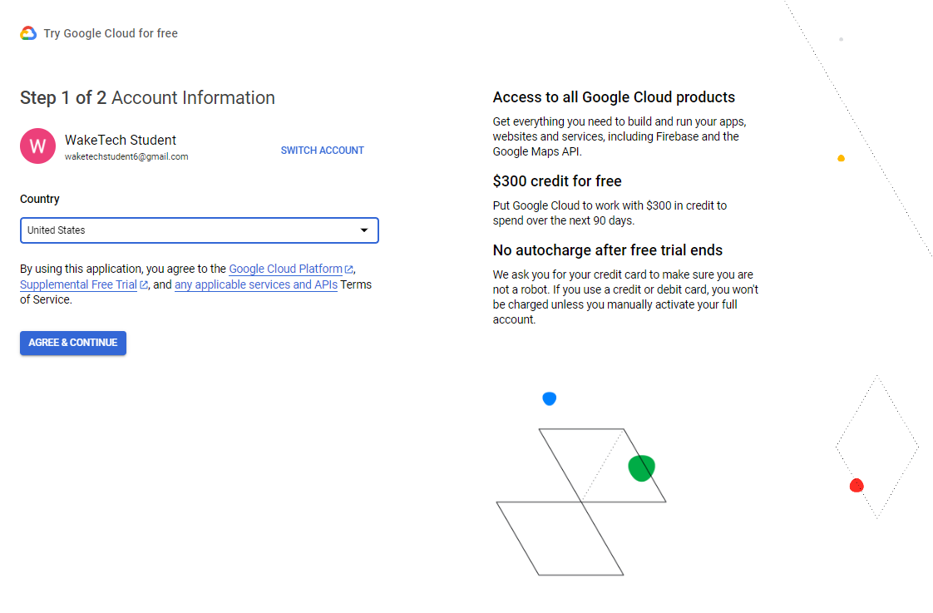
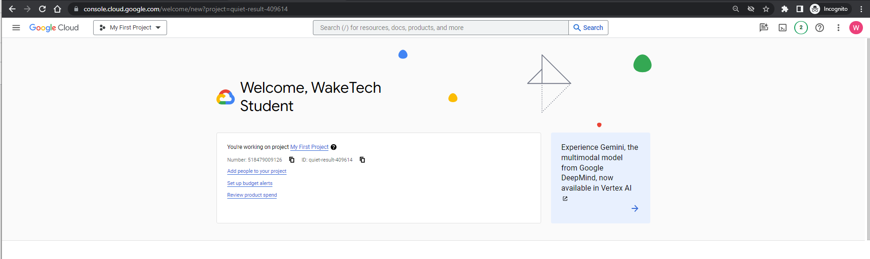
IoT
RPI
GCP
Google Cloud Platform (GCP)
STEP 1: Create GCP Account

Slide 22
IoT
RPI
GCP
Google Cloud Platform (GCP)
STEP 2: Create a new Project

Slide 23
IoT
RPI
GCP
Google Cloud Platform (GCP)
STEP 3: Enable APIs

Slide 24
IoT
RPI
GCP
Google Cloud Platform (GCP)
STEP 4: Create a Service Account

Slide 25
IoT
RPI
GCP
Google Cloud Platform (GCP)
GCP account setup
GCP encryption keys
Write code to read and print sensor data
Telemetry - Code to send data to cloud
BigQuery – build table to hold data

Slide 26
IoT
RPI
GCP
Google Cloud Platform (GCP)
Other reasons / ways to store historical data
Message Ingestion - Pub/Sub
Create Pub/Sub topic with a schema that matches BQ table – then create a subscription to write to BQ
Some discussion on JSON

Slide 27
IoT
RPI
GCP
Google Cloud Platform (GCP)
Alert – https://cloud.google.com/application-integration/docs/listen-pub-sub-topic-send-email
Reporting - LookerStudio Dashboard
Futures (code in repo)
Phase 2 for cooler local display of streaming data
Phase 3 – tie multiple student sensors together

Slide 28
KEEP LEARNING
COLLABORATE
STAY IN TOUCH!
NEXT STEPS!

Slide 29

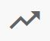
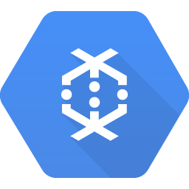

Data Warehouse BigQuery
BigQuery
Execution Results
Storage BigQuery
IoT Topic Cloud Pub/Sub
Processing Cloud Dataflow
Transaction Streams
Messaging Cloud Pub/Sub
Cloud Pub/Sub
Rules Actions
Stream Analytics Cloud Dataflow
Log Streaming Cloud Pub/Sub

